Slide 1
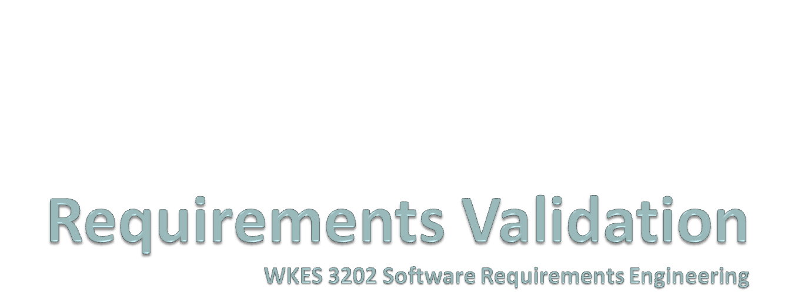

Slide 2
Validation objectives
Certifies that the requirements document is an acceptable description of the system to be implemented
Checks a requirements document for
  Completeness and consistency
  Conformance to standards
  Requirements conflicts
  Technical errors
  Ambiguous requirements

Slide 3
Analysis and validation
Analysis works with raw requirements as elicited from the system stakeholders
  “Have we got the right requirements” is the key question to be answered at this stage
Validation works with a final draft of the requirements document i.e. with negotiated and agreed requirements
  “Have we got the requirements right” is the key question to be answered at this stage

Slide 4
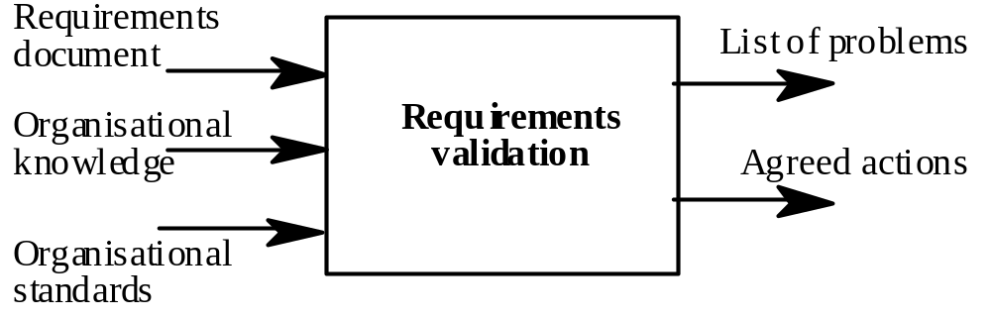
Validation inputs and outputs

Slide 5
Validation inputs
Requirements document
  Should be a complete version of the document, not an unfinished draft. Formatted and organised according to organisational standards
Organisational knowledge
  Knowledge, often implicit, of the organisation which may be used to judge the realism of the requirements
Organisational standards
  Local standards e.g. for the organisation of the requirements document

Slide 6
Validation outputs
Problem list
  List of discovered problems in the requirements document
Agreed actions
  List of agreed actions in response to requirements problems. Some problems may have several corrective actions; some problems may have no associated actions

Slide 7
Requirements reviews
A group of people read and analyse the requirements, look for problems, meet and discuss the problems and agree on actions to address these problems

Slide 8
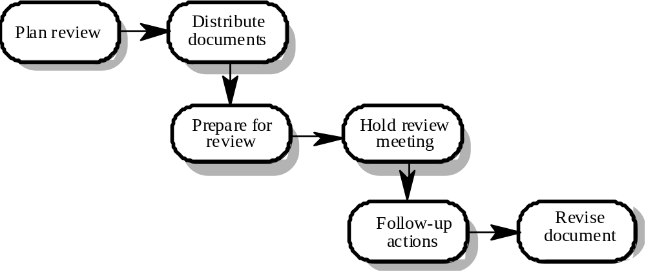
Requirements review process

Slide 9
Review activities
Plan review
  The review team is selected and a time and place for the review meeting is chosen.
Distribute documents
  The requirements document is distributed to the review team members
Prepare for review
  Individual reviewers read the requirements to find conflicts, omissions, inconsistencies, deviations from standards and other problems.

Slide 10
Review activities
Hold review meeting
  Individual comments and problems are discussed and a set of actions to address the problems is agreed.
Follow-up actions
  The chair of the review checks that the agreed actions have been carried out.
Revise document
  The requirements document is revised to reflect the agreed actions. At this stage, it may be accepted or it may be re-reviewed

Slide 11
Problem actions
Requirements clarification
  The requirement may be badly expressed or may have accidentally omitted information which has been collected during requirements elicitation.
Missing information
  Some information is missing from the requirements document. It is the responsibility of the requirements engineers who are revising the document to discover this information from system stakeholders.
Requirements conflict
  There is a significant conflict between requirements. The stakeholders involved must negotiate to resolve the conflict.
Unrealistic requirement
  The requirement does not appear to be implementable with the technology available or given other constraints on the system. Stakeholders must be consulted to decide how to make the requirement more realistic.

Slide 12
Pre-review checking
Reviews are expensive because they involve a number of people spending time reading and checking the requirements document
This expense can be reduced by using pre-review checking where one person checks the document and looks for straightforward problems such as missing requirements, lack of conformance to standards, typographical errors, etc.
Document may be returned for correction or the list of problems distributed to other reviewers

Slide 13
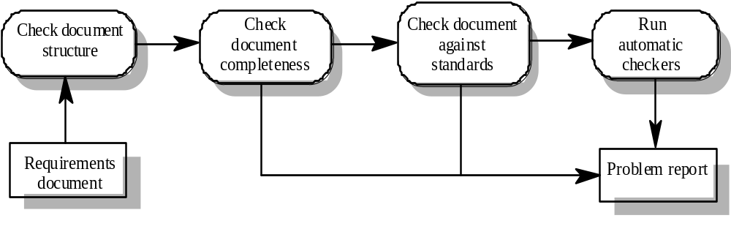
Pre-review checking

Slide 14
Review team membership
Reviews should involve a number of stakeholders drawn from different backgrounds
  People from different backgrounds bring different skills and knowledge to the review
  Stakeholders feel involved in the RE process and develop an understanding of the needs of other stakeholders
Review team should always involve at least a domain expert and an end-user

Slide 15
Review checklists
Understandability
  Can readers of the document understand what the requirements mean?
Redundancy
  Is information unnecessarily repeated in the requirements document?
Completeness
  Does the checker know of any missing requirements or is there any information missing from individual requirement descriptions?
Ambiguity
  Are the requirements expressed using terms which are clearly defined? Could readers from different backgrounds make different interpretations of the requirements?

Slide 16
Review checklists
Consistency
  Do the descriptions of different requirements include contradictions? Are there contradictions between individual requirements and overall system requirements?
Organisation
  Is the document structured in a sensible way? Are the descriptions of requirements organised so that related requirements are grouped?
Conformance to standards
  Does the requirements document and individual requirements conform to defined standards? Are departures from the standards, justified?
Traceability
  Are requirements unambiguously identified, include links to related requirements and to the reasons why these requirements have been included?

Slide 17
Checklist questions
Is each requirement uniquely identified?
Are specialised terms defined in the glossary
Does a requirement stand on its own or do you have to examine other requirements to understand what it means?
Do individual requirements use the terms consistently
Is the same service requested in different requirements? Are there any contradictions in these requests?
If a requirement makes reference to some other facilities, are these described elsewhere in the document?
Are related requirements grouped together? If not, do they refer to each other?

Slide 18
Requirements problem example
“4. EDDIS will be configurable so that it will comply with the requirements of all UK and (where relevant) international copyright legislation. Minimally, this means that EDDIS must provide a form for the user to sign the Copyright Declaration statement. It also means that EDDIS must keep track of Copyright Declaration statements which have been signed/not-signed. Under no circumstances must an order be sent to the supplier if the copyright statement has not been signed.”

Slide 19
Problems
Incompleteness
  What international copyright legislation is relevant?
  What happens if the copyright declaration is not signed?
  If a signature is a digital signature, how is it assigned?
Ambiguity
  What does signing an electronic form mean? Is this a physical signature or a digital signature?
Standards
  More than 1 requirement. Maintenance of copyright is one requirement; issue of documents is another

Slide 20
Problems with Req. Interaction
8 (i) The user interface will be html. Users will access EDDIS via standard web browsers such as Netscape and Internet Explorer
8(ii) EDDIS will be primarily an end-user system. Users will use the system within the constraints of the permissions assigned by the administrator to identify locate, order, and receive documents.
11(i) Users will communicate with EDDIS mainly via the html interface.
11(ii) User input to EDDIS will be via the html interface.

Slide 21
11(iii) EDDIS output to the user will be via the html interface, email and print. The print output will mainly be documents supplied which because of copyright restrictions, must be printed and deleted immediately upon receipt. The email output will be documents, messages from the system and other output.

Slide 22
Redundancy: Req 8(i) and Req. 11(i) : remove the first sentence in Req 8(i)
Conflict : Req. 8 (i) states that access is via Web browser; Req. 11(ii) states comm. Is via html
Completeness: Req 11(iii) states that the print output will be mainly documents… What are other outputs
Completeness: What versions of html and web browsers are assumed in Req 8(i0 and 11?

Slide 23
Prototyping
Prototypes for requirements validation demonstrate the requirements and help stakeholders discover problems
Validation prototypes should be complete, reasonably efficient and robust. It should be possible to use them in the same way as the required system
User documentation and training should be provided

Slide 24
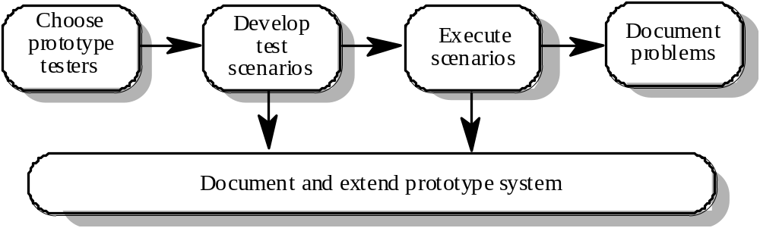
Prototyping for validation

Slide 25
Prototyping activities
Choose prototype testers
  The best testers are users who are fairly experienced and who are open-minded about the use of new systems. End-users who do different jobs should be involved so that different areas of system functionality will be covered.
Develop test scenarios
  Careful planning is required to draw up a set of test scenarios which provide broad coverage of the requirements. End-users shouldn’t just play around with the system as this may never exercise critical system features.
Execute scenarios
  The users of the system work, usually on their own, to try the system by executing the planned scenarios.
Document problems
  Its usually best to define some kind of electronic or paper problem report form which users fill in when they encounter a problem.

Slide 26
User manual development
Writing a user manual from the requirements forces a detailed requirements analysis and thus can reveal problems with the document
Information in the user manual
  Description of the functionality and how it is implemented
  Which parts of the system have not been implemented
  How to get out of trouble
  How to install and get started with the system

Slide 27
Model validation
Validation of system models is an essential part of the validation process
Objectives of model validation
  To demonstrate that each model is self-consistent
  If there are several models of the system, to demonstrate that these are internally and externally consistent
  To demonstrate that the models accurately reflect the real requirements of system stakeholders
Some checking is possible with automated tools
Paraphrasing the model is an effective checking technique

Slide 28
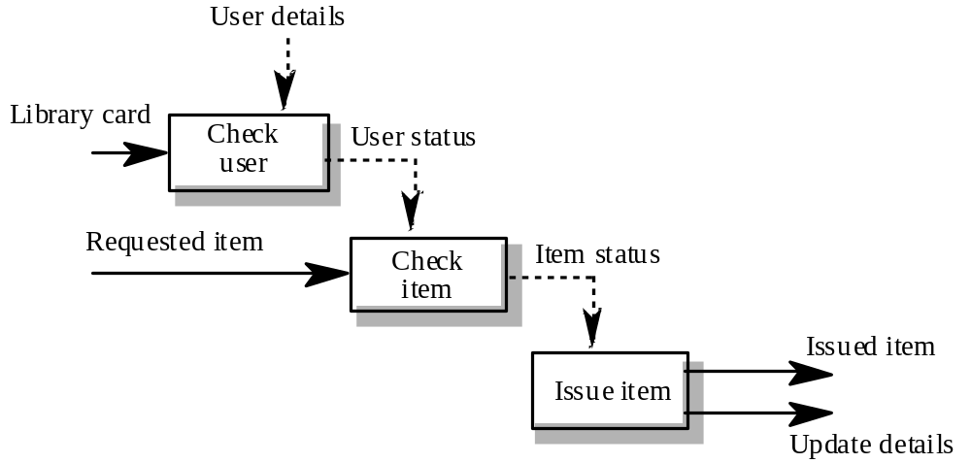
Data-flow diagram for Issue

Slide 29
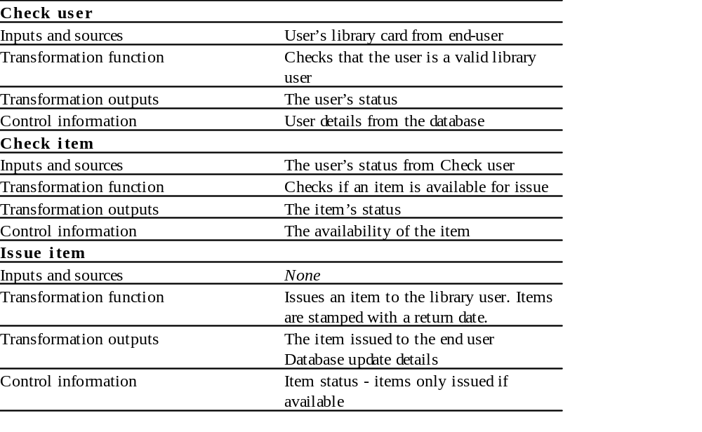
Paraphrased description

Slide 30
Requirements testing
Each requirement should be testable i.e. it should be possible to define tests to check whether or not that requirement has been met.
Inventing requirements tests is an effective validation technique as missing or ambiguous information in the requirements description may make it difficult to formulate tests
Each functional requirement should have an associated test

Slide 31
Test case definition
What usage scenario might be used to check the requirement?
Does the requirement, on its own, include enough information to allow a test to be defined?
Is it possible to test the requirement using a single test or are multiple test cases required?
Could the requirement be re-stated to make the test cases more obvious?

Slide 32
Test record form
The requirement’s identifier
  There should be at least one for each requirement.
Related requirements
  These should be referenced as the test may also be relevant to these requirements.
Test description
  A brief description of the test and why this is an objective requirements test. This should include system inputs and corresponding outputs.
Requirements problems
  A description of problems which made test definition difficult or impossible.
Comments and recommendations
  These are advice on how to solve requirements problems which have been discovered.

Slide 33
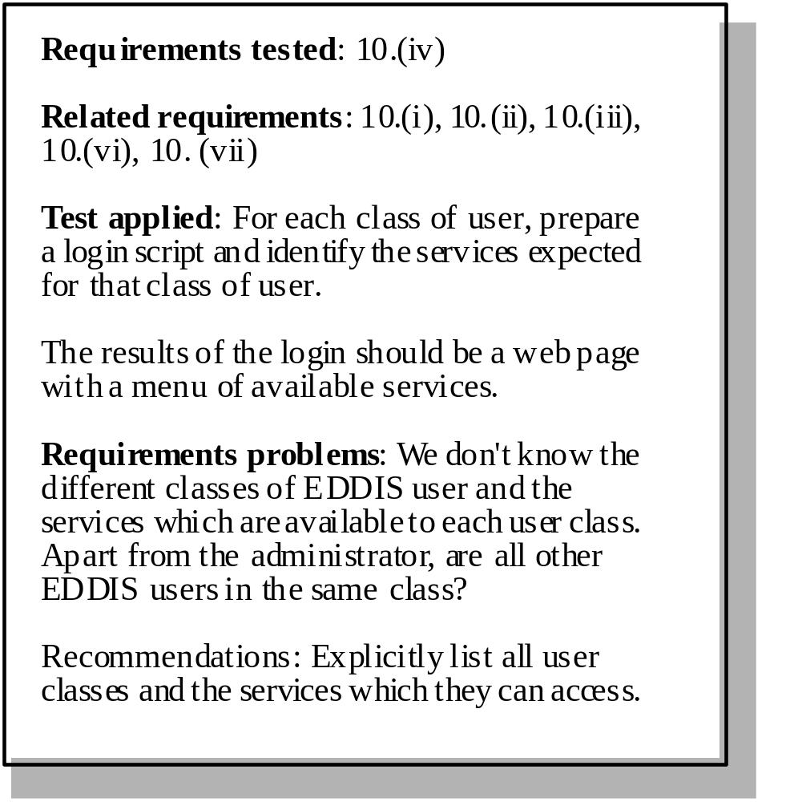
Requirements test form

Slide 34
Hard-to-test requirements
System requirements
  Requirements which apply to the system as a whole. In general, these are the most difficult requirements to validate irrespective of the method used as they may be influenced by any of the functional requirements. Tests, which are not executed, cannot test for non-functional system-wide characteristics such as usability.
Exclusive requirements
  These are requirements which exclude specific behaviour. For example, a requirement may state that system failures must never corrupt the system database. It is not possible to test such a requirement exhaustively.
Some non-functional requirements
  Some non-functional requirements, such as reliability requirements, can only be tested with a large test set. Designing this test set does not help with requirements validation.

Slide 35
Basing Test Cases on Product Requirement Documents
With a solid requirements document created it's fairly easy to create a test case document. Just get a soft copy of the requirements doc and modify it. The modification a requirements doc being converted to a test case needs depends in part on the format of the test case document being used. Starting with the requirements document (see Writing Requirements Documents), the examples shown below walk you through the process of converting a requirements document to a set of test cases.
Modifying General Page Appearance Requirements
Modifying General Page appearance requirements section 1.0.0 is mostly just a matter of changing the word "shall" to "is" or "are."
1.0.0 General Page Appearance Requirements
1.1.1 The title "Registration Page" shall be left aligned at the top of the page.
1.1.2 The words "Registration Page" shall be spelled correctly.
1.1.3 The words "Registration Page" shall be in 26 point type.
1.1.4 The words "Registration Page" shall be in sans serif type type.
Becomes
1.0.0 General Page Appearance Test Cases
1.1.1 The title "Registration Page" is left aligned at the top of the page.
1.1.2 The words "Registration Page" are spelled correctly.
1.1.3 The words "Registration Page" are in 26 point type.
1.1.4 The words "Registration Page" are in sans serif type type.

Slide 36
TEST CASE FORMAT OPTIONS
Case Number | Action | Pass/Fail
Case Number | Action | Expected Result | Actual Result | Pass/Fail

Slide 37
MODIFYING REQUIREMENTS FOR SIMPLE TEST CASE FORMATS
Requirement 2.1.1 needs very little modification to become test case 2.1.1. The requirement reads:
2.1.1 Entry with a blank First Name shall result in an error message being displayed saying The First Name must be filled in.
It becomes
2.1.1 Entering a blank First Name results in an error message being displayed saying The First Name must be filled in.
In the simple test case format, it looks like this:
Case Number | Action
2.1 | Entry with a blank First Name results in an error message being displayed saying The First Name must be filled in.

Slide 38
MODIFYING REQUIREMENTS FOR MORE COMPLEX TEST CASE FORMATS
Requirement 2.1.1 needs a little more modification to become test case 2.1.1 for a complex test case format than a simple one. The requirement reads:
2.1.1 Entry with a blank First Name shall result in an error message being displayed saying The First Name must be filled in.
It becomes
2.1.1 Action: Enter a blank First Name.
2.1.1 Expected Results: An error message is displayed saying The First Name must be filled in.
In the more complex test case format, it looks like this:
Case Number | Action | Expected Result | Actual Result | Pass/Fail
2.1 | Entry with a blank First Name. | An error message is displayed saying The First Name must be filled in.

Slide 39
Key points
Requirements validation should focus on checking the final draft of the requirements document for conflicts, omissions and deviations from standards.
Inputs to the validation process are the requirements document, organisational standards and implicit organisational knowledge. The outputs are a list of requirements problems and agreed actions to address these problems.
Reviews involve a group of people making a detailed analysis of the requirements.
Review costs can be reduced by checking the requirements before the review for deviations from organisational standards. These may result from more serious requirements problems.

Slide 40


Slide 41
Key points
Checklists of what to look for may be used to drive a requirements review process.
Prototyping is effective for requirements validation if a prototype has been developed during the requirements elicitation stage.
Systems models may be validated by paraphrasing them. This means that they are systematically translated into a natural language description.
Designing tests for requirements can reveal problems with the requirements. If the requirement is unclear, it may be impossible to define a test for it.

